Slide 1
Software
for the
Special Snowflake
using open-source software
in unique situations
&
Morgan Jones-King
Historic Properties Information Coordinator
mjones@scdah.state.sc.us
Notes:
Hello! Welcome to Software for the Special Snowflake: Using Open-Source Software in Unique Situations! I’m Morgan, and I currently work at the South Carolina State Historic Preservation Office (otherwise known as the SHPO). For some context, the SHPO operates as an office within South Carolina’s Department of Archives and History. In my position with the SHPO I’m using open-source technology to tackle a very unique problem – hence my title.
In this presentation, I’m going to cover the basis of my project (creating an online database) and what the SHPO wants accomplished. In addition, I’ll discuss why our office chose CollectiveAccess as the tool for the job. Since we’re an office with limited resources, I may have IT staff and other archivists to support me but not necessarily help me set up the system. Keeping that in mind, I’ll also cover the experience of installing, formatting, and using a new open-source tool as an archivist with a limited amount of coding experience.
Finally, I’ll discuss the takeaways from this project, why I would choose to use open-source software in the future, and how CollectiveAccess has been a success for us.
Before we get too far into my presentation, my producer is going to put up a poll that I’d like everyone to answer. We’re going to find out how many people here are familiar with the office comic strip, Dilbert!
…Ok, so I see some of you are familiar with Dilbert! It’s become one of my favorite comic strips lately. For those of you who haven’t read Dilbert, I hope this presentation will give you some appreciation for Scott Adam’s humor! Let’s get started. Please feel free to type questions into the chat box. I will answer all of them at the conclusion of my presentation.

Slide 2
lots special
such unique
very open-source
much customize
wow code
Notes:
Ok, first, I want to tackle the title of my presentation: Software for the Special Snowflake.
Special Snowflake Syndrome is the idea that you as an individual are unique, extraordinary, and exceptional. There is no one else like you in the world! You are your own special snowflake.
The cynical portion of our population will accuse someone of having special snowflake syndrome and mean it as a jab at their naïveté or over-inflated sense of self. But in the world of libraries, archives, and various other cultural heritage institutions, it’s true that though we may share similarities in missions, goals, and even obstacles, each establishment is different: its own snowflake with its own distinctive needs.
And to me, that’s the power of open-source software. These tools not only appeal to the parallels between us but can also be tailored to our disparate requirements. So, that’s where we’re starting in this presentation: with the power of open-source software to be of use in unique situations.

Slide 3
A
universal, searchable, publicly available
DATABASE
for all of South Carolina’s recorded historic properties
Notes:
In the words of the immortal Mick Jagger and Keith Richards: You can’t always get what you want, but you CAN get what you need.
This is the struggle for heritage institutions everywhere and the struggle that the SC SHPO faced when I came on board. What do we want? What do we need? What is achievable in the balance in between the two?
So, to be clear, the South Carolina SHPO hired me to design, create, and populate a universal, searchable, publicly available database to house all of the state’s recorded historic properties. This is a big deal, because while the SHPO might have all of the information on these properties in the office and on their network, somewhere, it isn’t unified. Moreover, it’s in the office or in the archives. And the finding aid for that part of the collection isn’t descriptive enough for people to search for properties without coming to our building, consulting with staff, and then wading through box after box to find one historic home. So this is a problem both for staff and outside researchers.
What the SHPO needs then, is essentially, a database that is a finding aid with item-level description for each site card.

Slide 4
Notes:
Here‘s an example: A site card represents information about a property when it was surveyed. It includes one to three pictures and details like foundation material, architect, date constructed, and architectural style. So, this database will need a metadata schema unique to historic preservation AND archives, an intense browse capability, and a robust advance search function. It needs to be useable by the layman and by the professional preservationist.

Slide 5
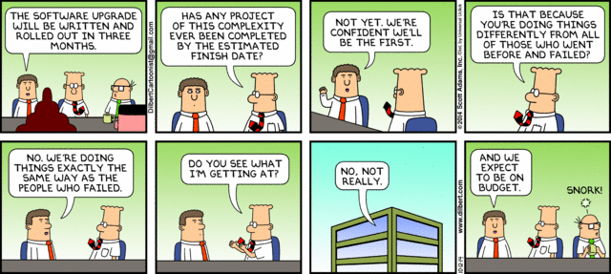
how NOT to build
the Historic Properties Database
Notes:
I’ll give everyone a minute to go through this strip.
What was the lead up to choosing a software to build what we’re now calling the SC Historic Properties Database? A lot of research. I found this comic when I was reading the Sunday paper at my in-laws (because they do still get the paper), and it perfectly described everything I wanted to avoid. I DIDN’T want to replicate anyone’s failings! I DIDN’T want to make promises of a quick delivery and then never follow through! And I DIDN’T want to go over budget!
In the words of Wally: “Snork.”
So, I looked for the SHPOs that had online databases and got in touch with their staff. What I discovered first, was that each SHPO seemed to have mostly custom built their database. Some of them partnered with an institution while others received a large grant to get the project done. A fair number of them operated the database on MySQL. Finally, all of them had similar but unique metadata schemas with different vocabularies and fields. This research was the basis for the next part of my project: finding software that could do the job for us in an efficient and cost-effective manner while allowing for a unique metadata schema.

Slide 6
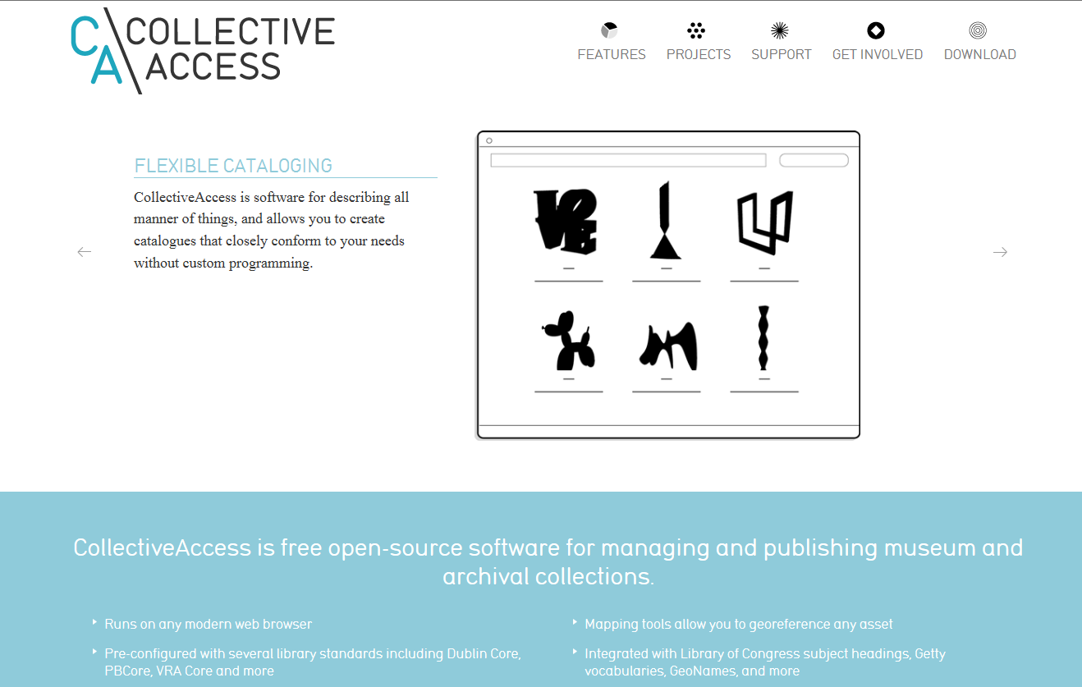
Why CollectiveAccess?
Notes:
This is a screenshot of the CollectiveAccess homepage at collectiveaccess.org. I’ll type that web address into the chat bar for you all.
I can’t say I remember how I found CollectiveAccess, but I know that prior to discovering it, I had a long list of other possibilities that almost but didn’t quite fit the bill for the Historic Properties Database. Once I stumbled across CollectiveAccess though, why did I choose to take it for a spin?

Slide 7
Because…
Uses a MySQL database backend
Allows for ANY metadata schema
Offers extensive item-level description
Notes:
Like many of the online databases that other SHPOs produce, CollectiveAccess operates off of MySQL. At this point, I had already downloaded and installed MySQL and created a rudimentary historic properties database. I would be happy to continue in that vein. Moreover, MySQL is free!
CollectiveAccess offers a variety of pre-set installation packages with different metadata schemas. One for PBCore, one for EAD, one for DublinCore…you get the idea. That versatility was a big draw. So CollectiveAccess not only had a package that could work for describing historic preservation data, but they also allow customization of the installation package and metadata.
The upside to CollectiveAccess is the robust system for item-level description while allowing for collection level metadata as well. This system bridged the gap perfectly for me between an archival content management system and an artifact management system. This specification was important to me because at the end of the day, the SHPO database would essentially do both. It will provide information on the archival record of the physical card as well as data on the material artifact that is the historic property.

Slide 8
Because…
Supports a wide variety of projects
Notes:
Just looking through the projects that have used CollectiveAccess reassured me that it would be a good fit for us. As I’ve already said, I wanted a system that could bridge the gap. Seeing websites ranging from the Mattress Factory in New York to the Eggshell and Fossil Database in Colorado convinced me that CollectiveAccess would fit the niche need of a preservation office within an archive.

Slide 9
Because…
Developers offer an attentive support system
Via
Forum & Documentation Wiki
Notes:
The developers of CollectiveAccess offer support through an open forum (which is very easy to use by the way) and a documentation wiki. They always answer questions quickly, and they are genuinely interested in the projects that use their tool and the possibilities these projects reveal. A support system is vital when choosing an open-source tool.

Slide 10
Because…
We have the chance to give back to the archival community!
Notes:
I watched a show recently where a character was asked why they took a job in party planning if they studied library science. The answer (though expected) was still unwelcome to me: “I decided I wanted to work more with people.”
Well, I’ve found that the library and archive community is just that: a community. I’m saddened every time people assume librarians and archivists are antisocial or take their jobs so that they can avoid interaction. It’s not true! My personal rant aside, being able to give back to the community of users is another reason I like CollectiveAccess (and open-source in general). We have the ability to innovate and inject those innovations (in the form of code) into the tech stream of library, archive, and cultural heritage work.

Slide 11
Because…
It’s Free*!!!
Notes:
Finally, one of the key attractions? It’s free! Many cultural heritage institutions struggle with funding, and no matter how much or little you have, a robust free tool can be a big feather in your cap.
Now, why is there an asterisk next to free? Because CollectiveAccess is only really free in terms of dollar signs. It won’t cost an institution anything to download it or configure the necessary system requirements, but it will require a lot of time and energy to get it just the way you want it. So “Free” is a relative term. But in the monetary sense, it won’t cost a dime.

Slide 12
Great!
Now I need to…
Install
Format
Populate
Simple enough, right?

Slide 13
Sort of…
Install
Write an installation profile for Pawtucket
Format
Build a website
Populate
Standardize existing data
Install Providence
Install supplementary software needs

Slide 14
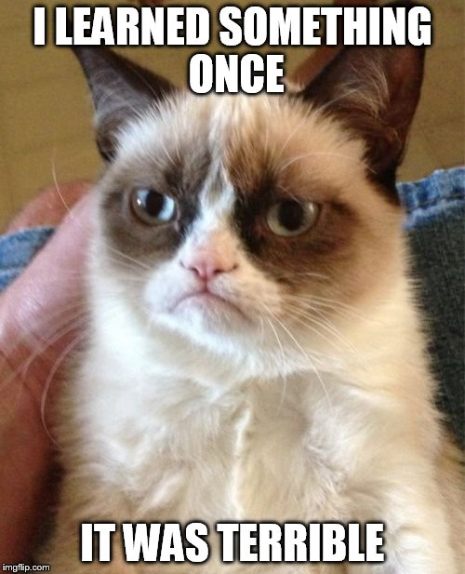
The Takeaways

Slide 15
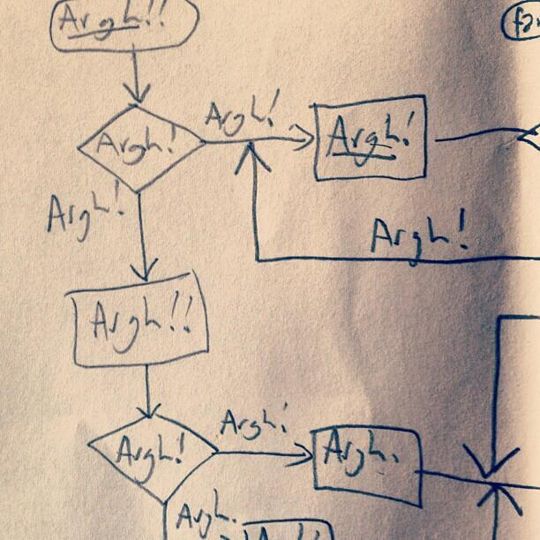
Frustrated? Just ask a question! Even if you think it might be stupid.

